Slide 1
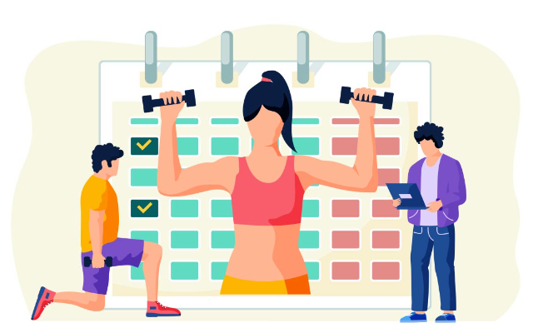
Exercise and Fitness Metrics: How to achieve your goals using data analytics
Project 3 – Group 3

Slide 2

Copyright Protections:
This license grants users certain rights to use and publish the data under specific conditions. Each Data Provider agree that Enhanced Data shall not be considered a work of joint authorship by virtue of its relationship to Data licensed under this Agreement and shall not require either any obligation of accounting to or the consent of any Data Provider. Each Data Provider represents that the Data Provider has exercised reasonable care, to assure that: (a) the Data it Publishes was created or generated by it or was obtained from others with the right to Publish the Data under this Agreement; and (b) Publication of such Data does not violate any privacy or confidentiality obligation undertaken by the Data Provider.

Slide 3

Fair Use Analysis:
The license explicitly outlines the rights and permissions granted to users, including the ability to use, modify, and publish the data. However, users must comply with the conditions outlined in the agreement, such as preserving attributions to the data providers and not imposing further restrictions on the data's use.

Slide 4

Data Collection:
the dataset is provided under a specific license agreement that grants users certain rights to use and publish the data, subject to compliance with the conditions outlined in the agreement. As long as users adhere to these conditions, their use of the dataset should be within the bounds of fair use and the terms of the license agreement.

Slide 5

Project Proposal:
Our project aims to provide valuable insights and create a clear, modified dataset ready for any user to explore and derive meaningful conclusions. We recognize the importance of accessible and well-organized data in driving informed decision-making and uncovering hidden patterns. Therefore, our primary goal is to enhance the usability and clarity of the dataset, making it an invaluable resource for researchers, analysts, and enthusiasts across various domains.

Slide 6
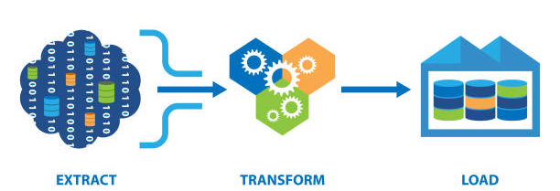
Workflow

Slide 7

Extraction

Slide 8
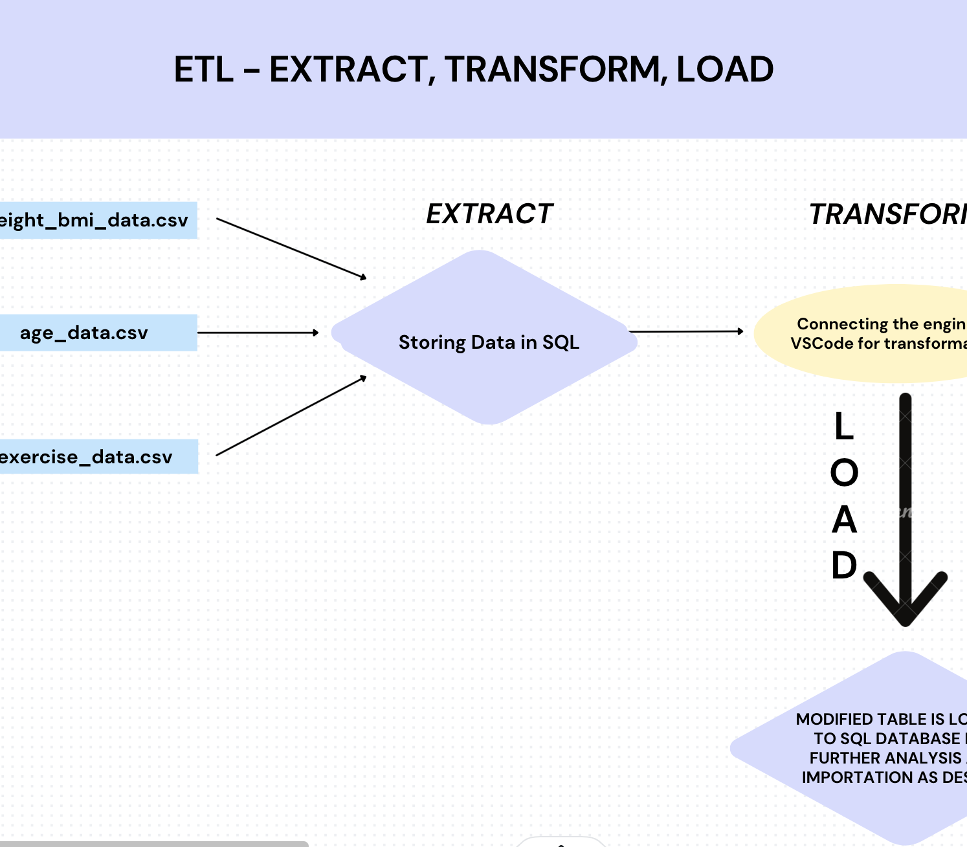
Initial Data Retrieval
Data Sourcing: Relevant and reliable data was collected from Kaggle for the project.
Data Preparation: The collected data underwent refinement and was organized into three CSV files for easier management.
Database Design: To manage the data effectively, an Entity-Relationship Diagram (ERD) was created to understand the connections between different pieces of information. Primary and foreign keys were defined to maintain data integrity.
Database Creation: A new database was established to house the curated data.

Slide 9
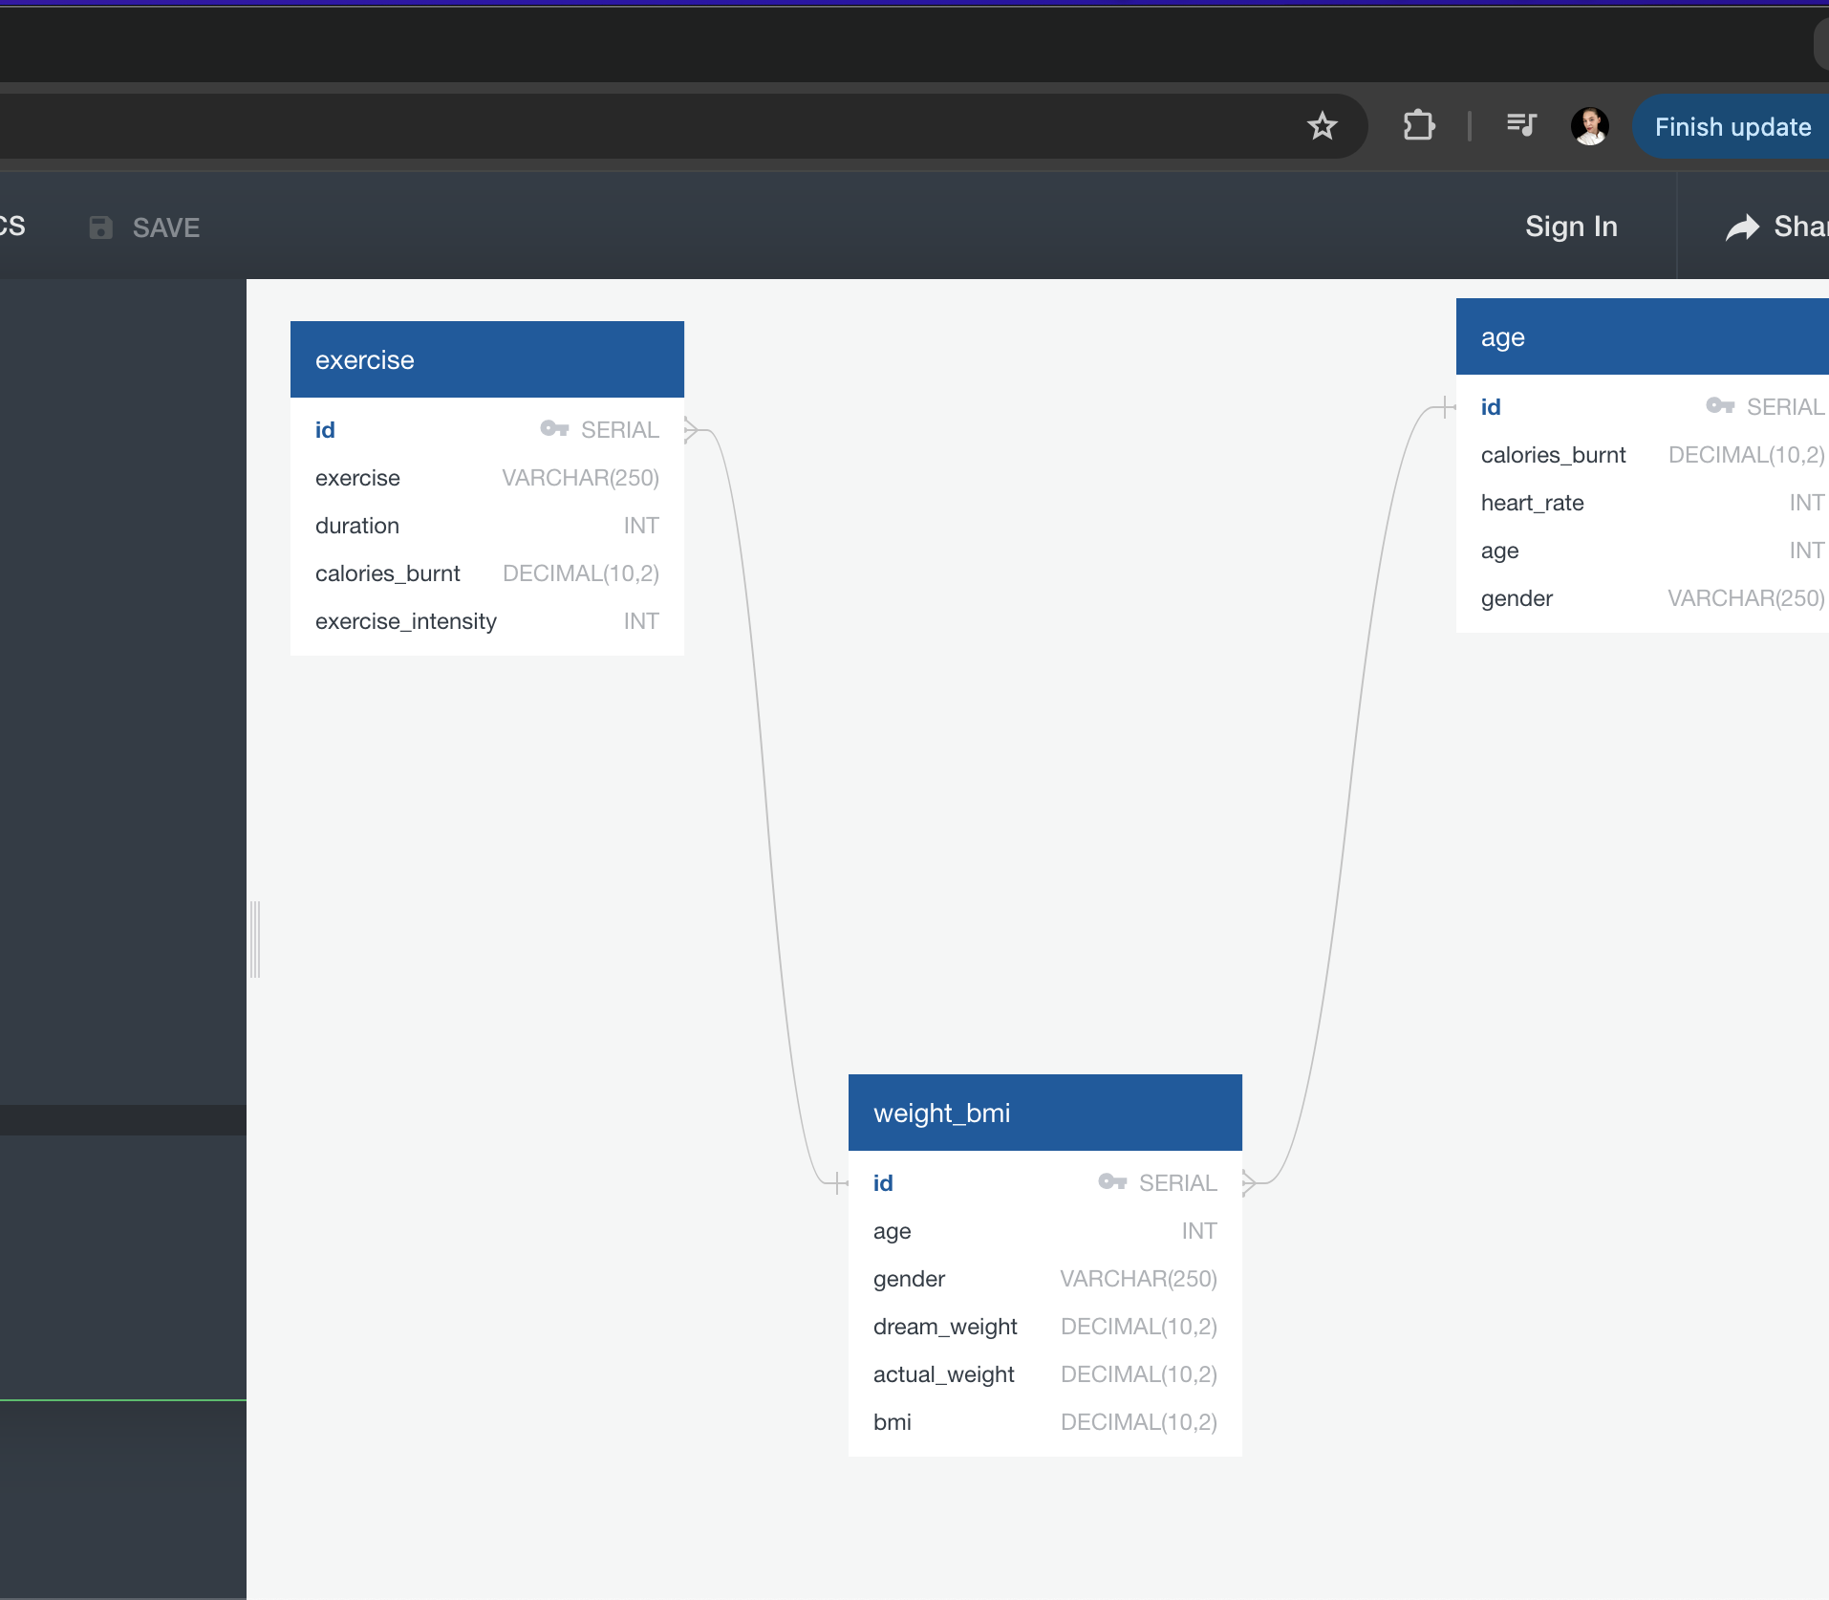
Ongoing Data Extraction
Table Creation: Within the newly created database, tables were set up using predefined structures to accommodate the various datasets.
Data Import: The CSV files were imported into their corresponding tables within the database, ensuring that the data was correctly formatted and organized.
Verification: Checks were performed to ensure that the imported data was accurate and complete.
Database Connectivity: An engine connection was established to the SQL database, allowing for seamless interaction and analysis of the data within Jupyter Notebook or other analysis tools.

Slide 10

Transform

Slide 11
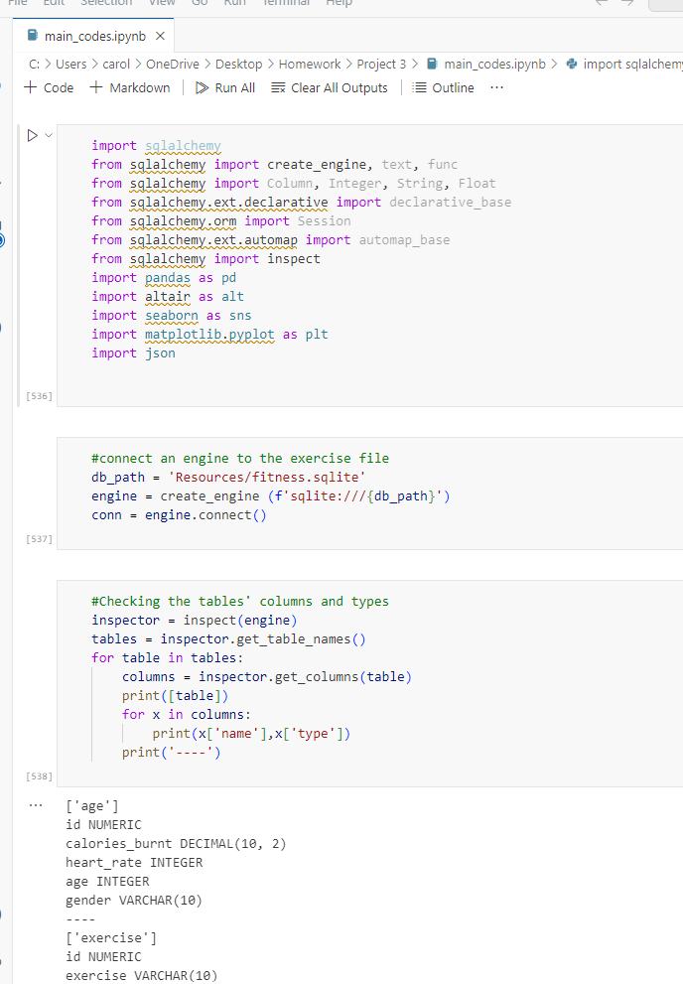
Data Integration, Normalization, and Analysis Pipeline
The data transformation process involved merging tables 'exercise_df' and 'age_df' based on 'id' and 'calories_burnt', followed by merging the resulting table with the 'weight_bmi_df' table on 'id', 'age', and 'gender'. Columns were rearranged, renamed for clarity, and data types were adjusted for numerical manipulation ease. Caloric values were normalized to a 60-minute duration, gender entries were converted to binary, and average calories burnt for each exercise type were computed.

Slide 12
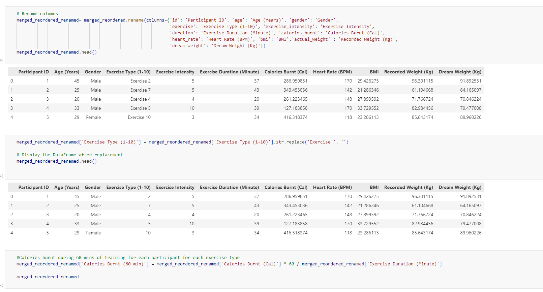
Data Integration, Normalization, and Analysis Pipeline
The top two exercises with the highest average calories burnt within 60 minutes were identified, and the ratio of participants from each gender for these exercises was analyzed to ensure a balanced representation. Finally, the dataset was filtered to include data for the selected exercises, reducing the size by 80% for the final analysis.

Slide 13
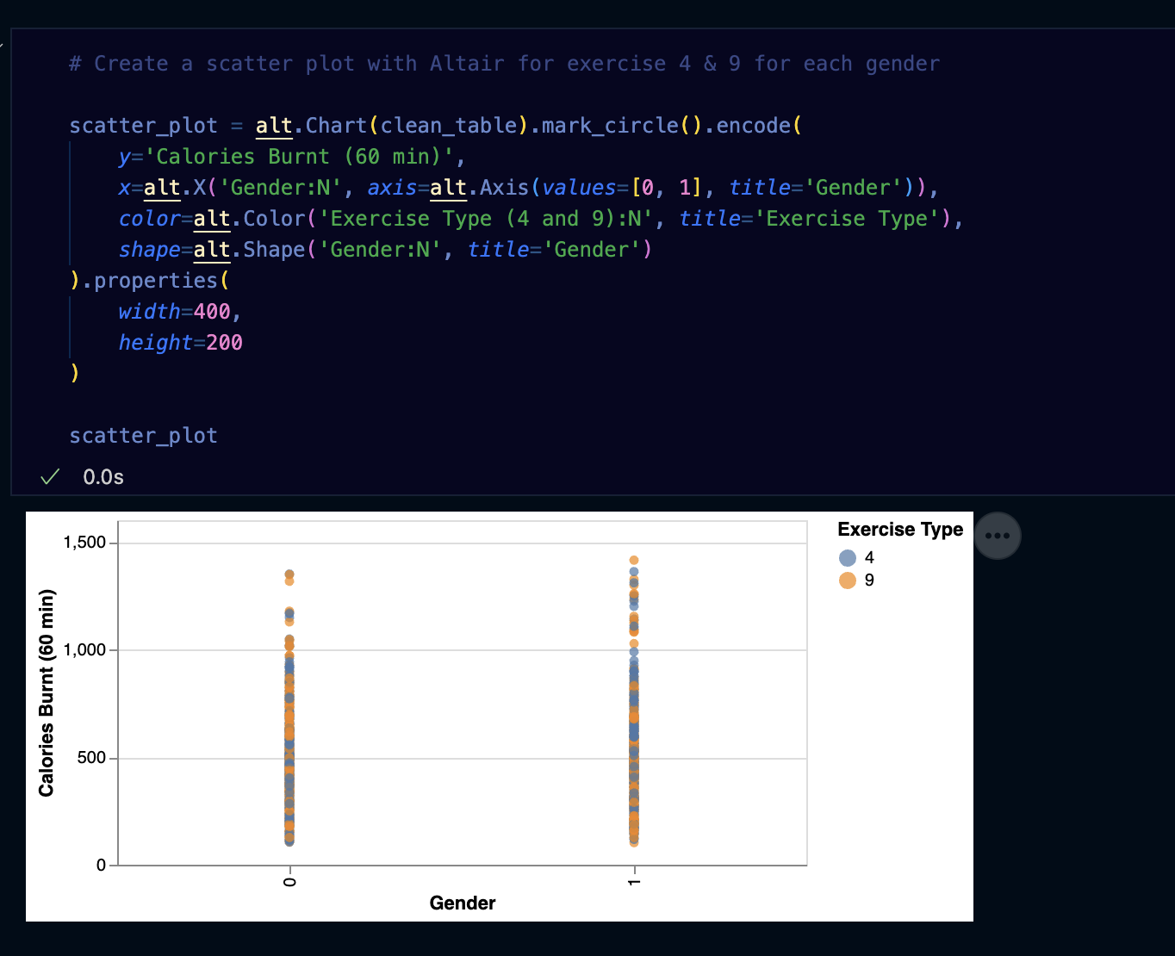
Analysis: Seaborn and Altair
"Vega-Altair is a declarative visualization library for Python. Its simple, friendly and consistent API, built on top of the powerful Vega-Lite grammar, empowers you to spend less time writing code and more time exploring your data."

Slide 14
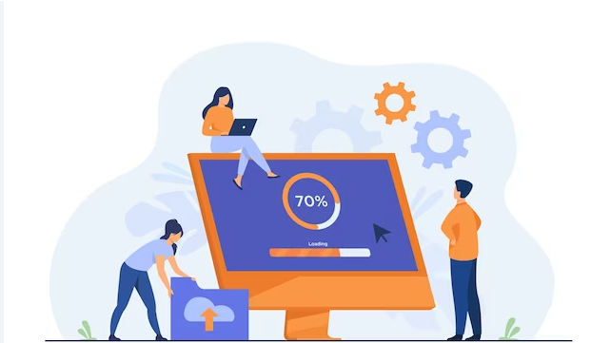
Load

Slide 15
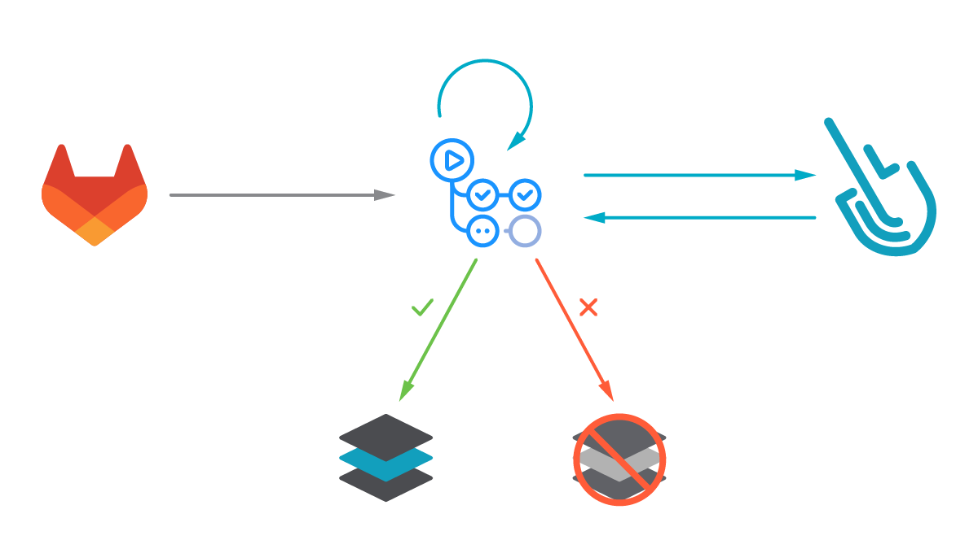
Importing, organizing, and storing
The "load" phase involves the process of organizing and storing the curated data into a structured database, making it accessible for querying and analysis by users. In this context, the data loading process includes not only importing the data into a database but also ensuring that it is hosted in a manner that allows users to interact with it remotely.

Slide 16
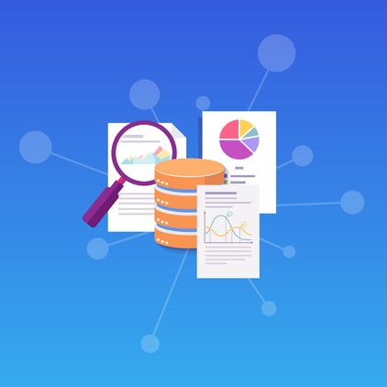
Importing, organizing, and storing
During the loading phase, steps are taken to optimize the database for efficient querying. This include creating indexes on columns frequently used in queries, optimizing table structures for performance, and implementing security measures to control access to the database.

Slide 17

Final Conclusions:
In conclusion, our final project has provided valuable insights into various aspects of exercise, weight management, and their relationship with age and gender. By understanding these relationships, we can develop more tailored and effective strategies for promoting health and well-being across diverse populations.

